Slide 1
Introduction
to
network layer

Slide 2
Layer #3 – NETWORK
The network layer is responsible for the delivery of packets from the original source ( Host ) to the final destination ( Host ) across the network

Slide 3
Network Layer duties / functions
Create Packet [Protocol Data Unit of Network Layer]
Addressing – Take care of uniquely identifying host
Routing-execute routing algorithm to determine paths across the network
Forwarding – Send the packet arriving at the input port to right output port ( transfer packet across a node)
Congestion control to deal with traffic jam
Connection setup, maintenance, and teardown
Quality Of Service connection-based

Slide 4
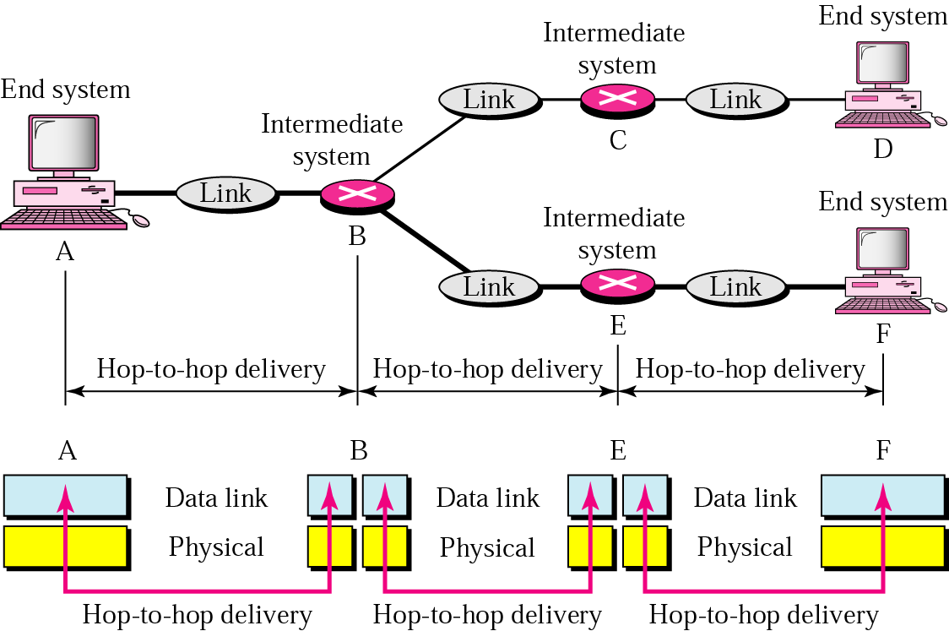
Node-to-node delivery
Network
Host 2
Host 1
Packet
Packet
Packet

Slide 5
















Network layer
transport segment from sending to receiving host
on sending side encapsulates segments into datagrams
on receiving side, delivers segments to transport layer
network layer protocols in every host, router
router examines header fields in all IP datagrams passing through it
application
transport
network
data link
physical
network
data link
physical
network
data link
physical
network
data link
physical
network
data link
physical
network
data link
physical
network
data link
physical
network
data link
physical
network
data link
physical
network
data link
physical
application
transport
network
data link
physical
network
data link
physical
network
data link
physical

Slide 6
Two key network-layer functions
forwarding: move packets from router’s input to appropriate router output
routing: determine route taken by packets from source to dest.
routing algorithms
analogy:
routing: process of planning trip from source to dest
forwarding: process of getting through single interchange

Slide 7
Interplay between routing and forwarding
routing algorithm
routing algorithm determines
end-end-path through network
local forwarding table
forwarding table determines
local forwarding at this router
header value
output link
0100
0101
0111
1001
3
2
2
1
value in arriving
packet’s header
0111
1
3
2

Slide 8
Network service model
Q: What service model for “channel” transporting datagrams from sender to receiver?
example services for individual datagrams:
guaranteed delivery
guaranteed delivery with less than 40 msec delay
example services for a flow of datagrams:
in-order datagram delivery
guaranteed minimum bandwidth to flow
restrictions on changes in inter-packet spacing

